Slide 1
Hostel Management System
By Smit Padshala (21BCP187),
Tej Joshi (21BCP190)

Slide 2





Problem Statement
Currently, the whole hostel admission process and all other hostel administration is done on paper manually.
We have developed a platform that automate the management of hostel activities, including registering and applying, room allocation, check-in, check-out, attendance, different applications, and inventory management. Administrators can allocate the rooms to eligible candidates based on their merit rank and home town distance.
An automated Hostel Management System would significantly improve efficiency, accuracy, and user experience for both students and administrators. It would reduce manual effort, provide real-time updates, enable data-driven decisions, and enhance communication and resource allocation.
Tech Used

Slide 3
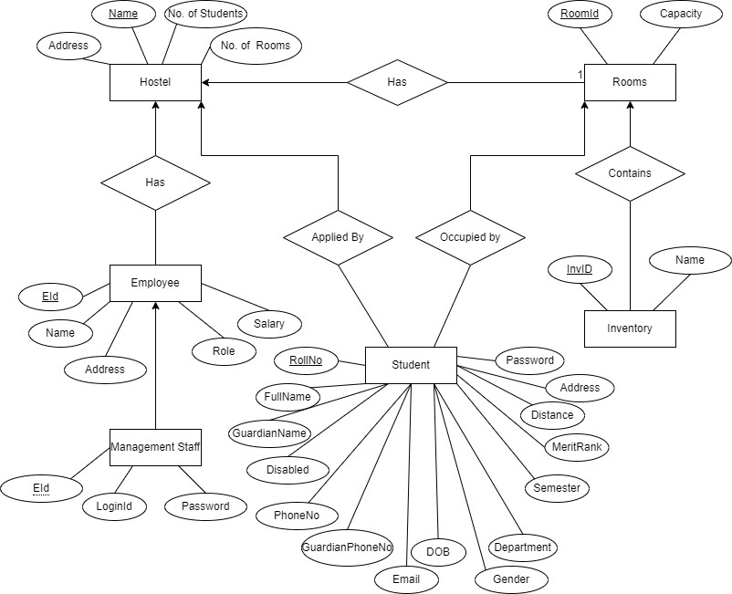

Types of user:
ER Diagram
Admin User:
Allocate rooms
Check Rooms occupancy
Access student database to add or remove students
Student User:
See or update Student information
Apply for leave
File complains
Warden User:
Mark attendance
Check In/Out of students
Inventory management

Slide 4
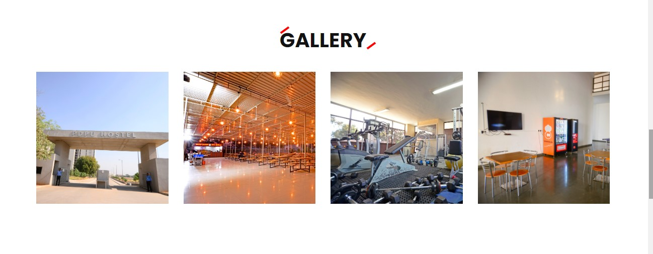
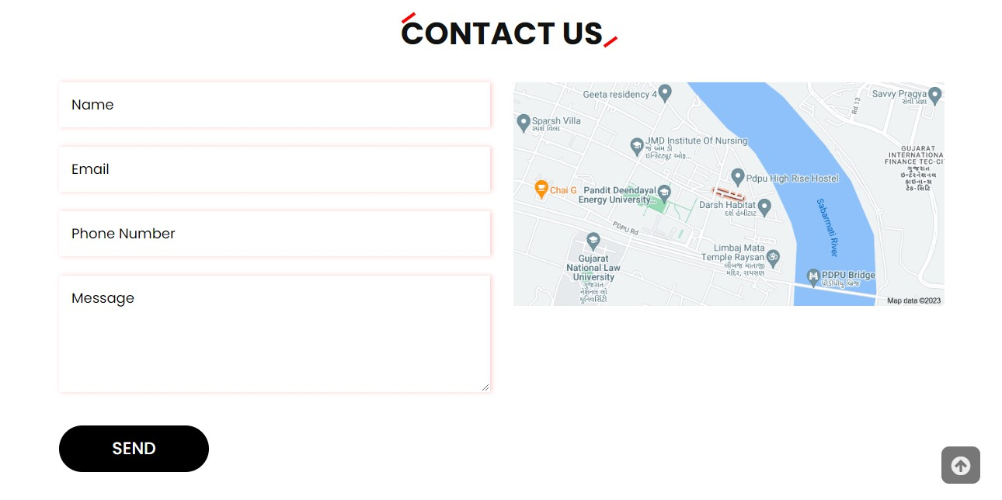
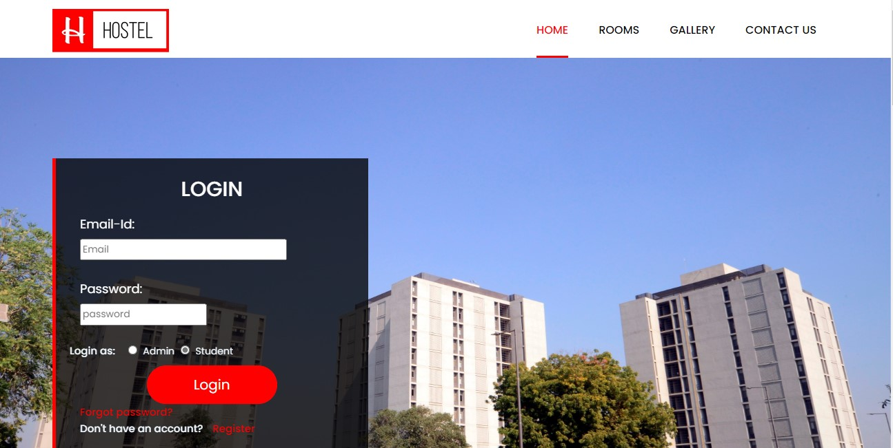
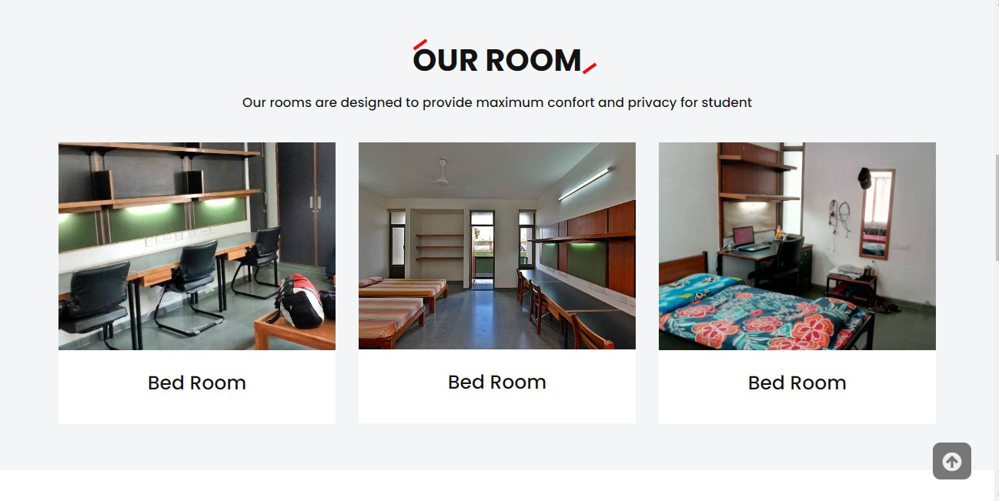
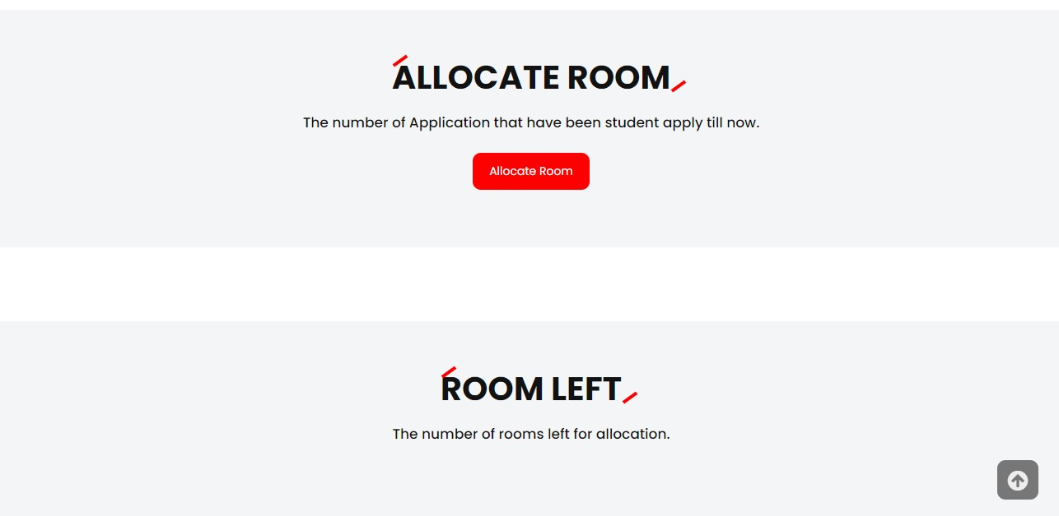
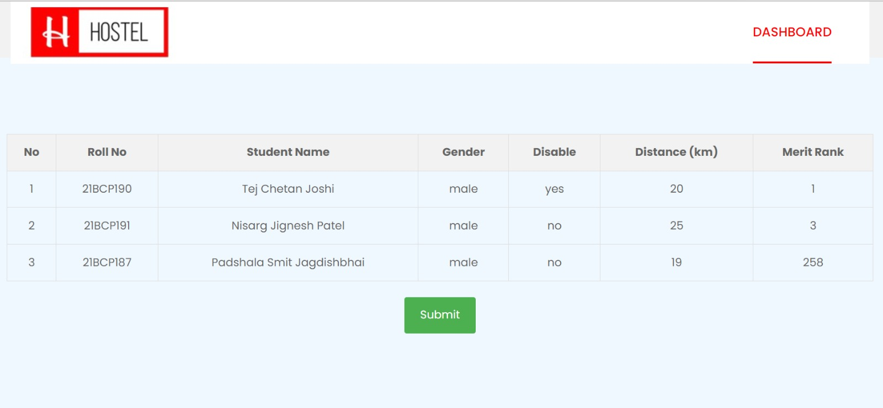
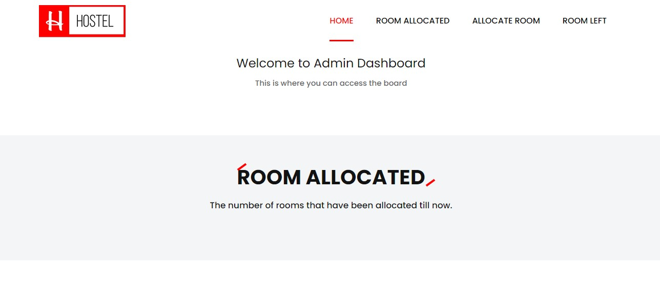
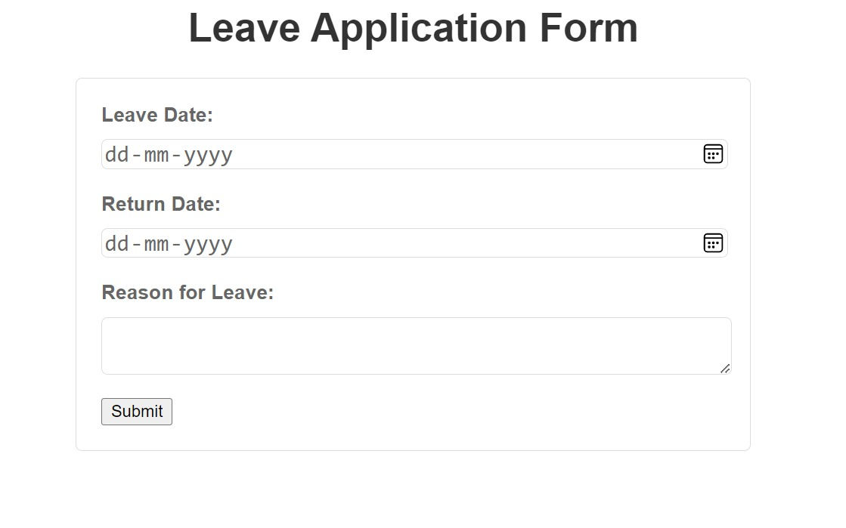
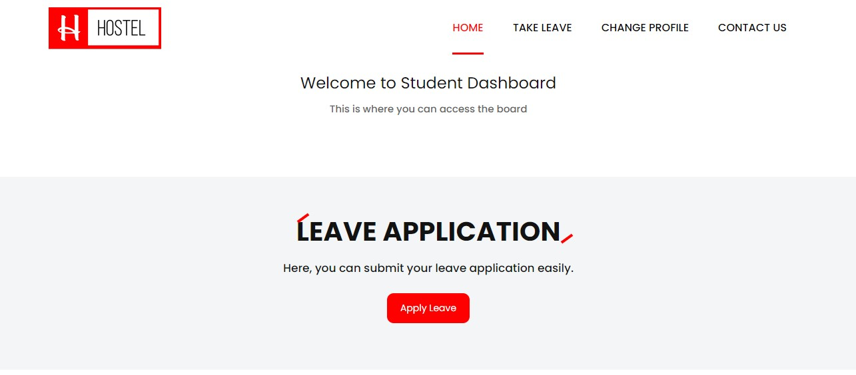
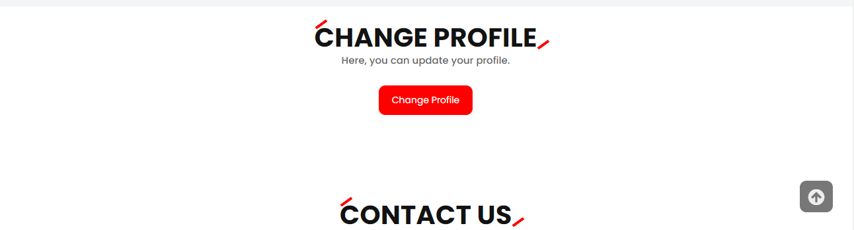
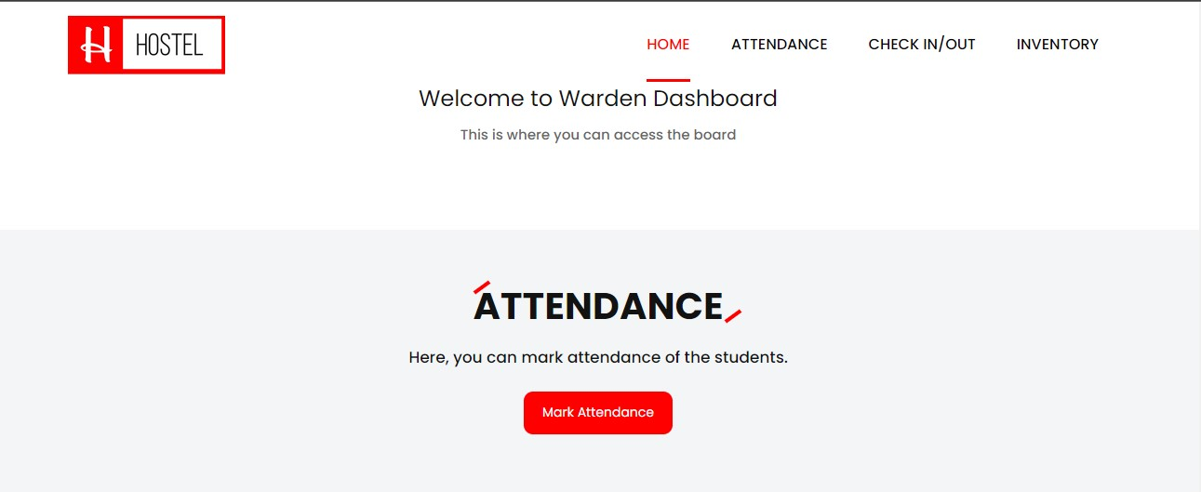
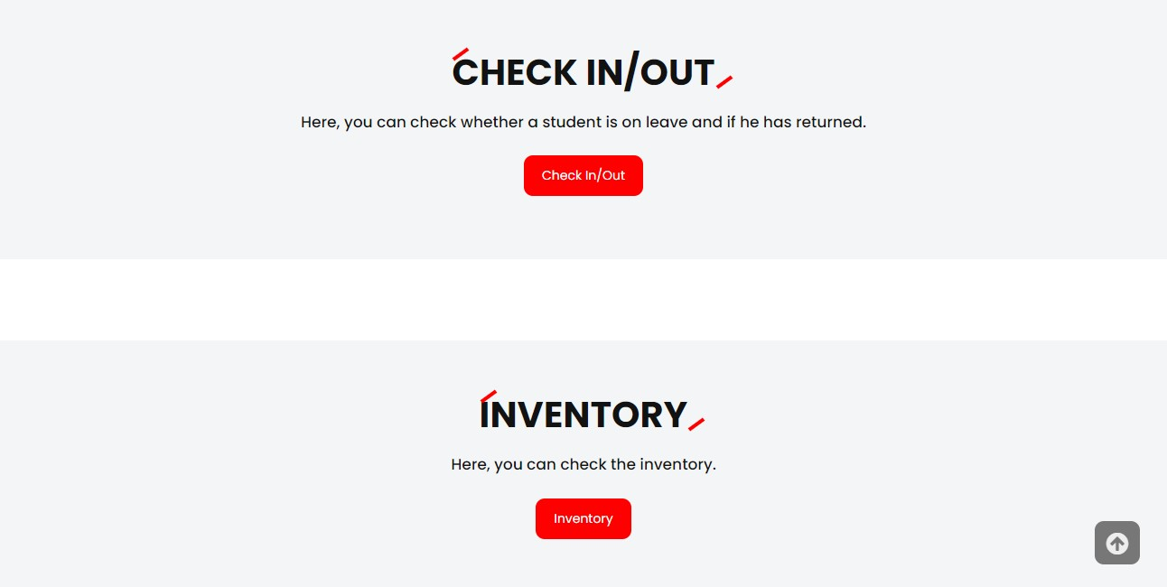
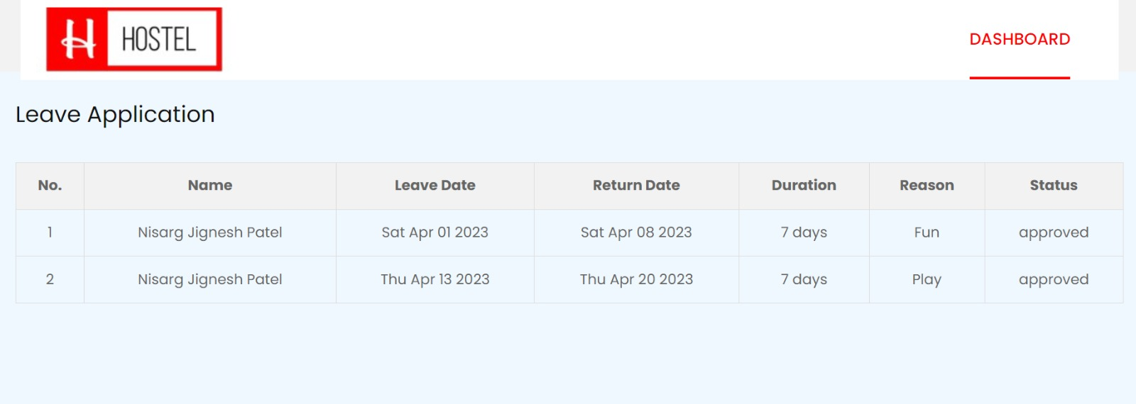
Home page
Admin
Dashboard
Student
Dashboard
Warden
Dashboard

Slide 5
Thank you!!!

